Slide 1
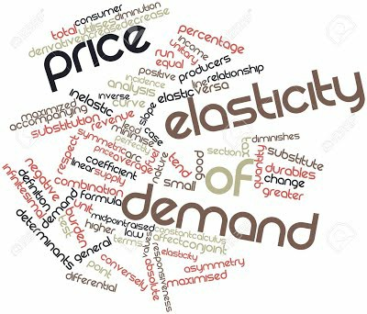

Slide 2
PRICE ELASTICITY OF DEMAND
Price elasticity of demand refers to degree of responsiveness of demand of a commodity to a change in its price

Slide 3
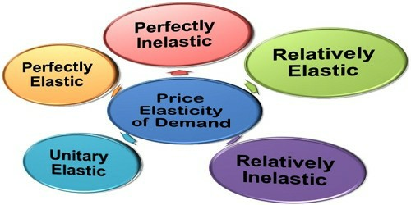
DEGREES OF ELASTICITY OF DEMAND

Slide 4
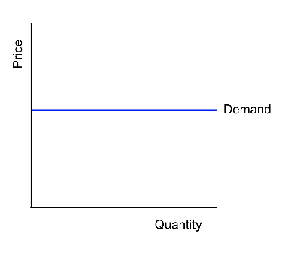
1. PERFECTLY ELASTIC DEAMND
A small change in price leads to inﬁnite change in quantity demanded. The demand curve is a horizontal line parallel to X axis.
Ed = Ꝏ

Slide 5
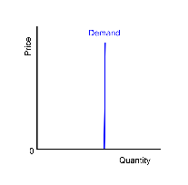
2. PERFECTLY INELASTIC DEMAND
When change in price of a good does not cause any change in quantity demanded, it is called Perfectly Inelastic Demand. Demand curve is a straight line parallel to Y axis.
Example: Demand for Medicines
Ed = 0

Slide 6
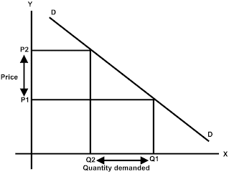
3. UNITARY ELASTIC DEMAND
Percentage change in Price and Percentage Change in quantity demanded are equal.
Ed = 1

Slide 7
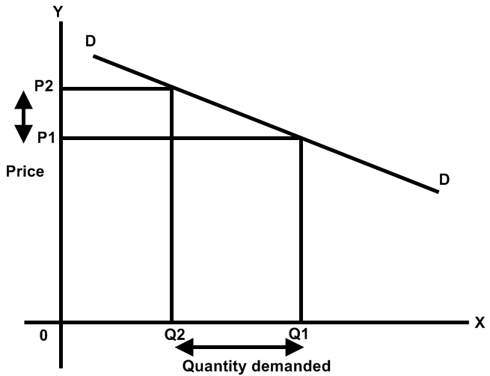
ELASTIC DEMAND
(RELATIVELY ELASTIC DEMAND OR GREATER THAN UNIT ELASTIC)
Percentage change in quantity demanded of a good is greater than percentage change in its price.
Ed > 1

Slide 8
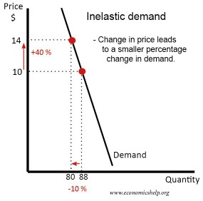
INELASTIC DEMAND
(RELATIVELY INELASTIC DEMAND OR LESS THAN ELASTIC DEMAND)
Percentage change in quantity demanded of a commodity is less than percentage change in its price.
Ed < 1

Slide 9
FACTORS THAT INFLUENCE PRICE ELASTICITY OF DEMAND OF A GOOD
Nature of the Commodity:
The demand for essential goods like medicines and
food materials is inelastic.
The demand for luxury goods is mostly elastic.
Proportion of income spent:
The goods on which we spend smaller proportion
of our income are inelastic.
The consumer does not bother about the change
in their prices. Ex: Salt, Match Box, Pencil.

Slide 10
(iii) Several Uses:
The commodities which have several uses like electricity, coal etc. have elastic demand.
The fall in their prices will encourage consumer to
uses them for new purposes.
(iv) Habits and Addiction: Demand for liquor and cigarette is inelastic because the consumer is addicted to them.

Slide 11
(v) Income Level:
Rich people do not bother much about price rise.
They do not reduce consumption even if price rises.
(vI) Availability of close substitutes:
The goods that have close substitutes have elastic demand.
The goods that do not have substitutes have inelastic
demand.

Slide 12
•

